Slide 1
Web APIs
Module 04

Slide 2
What is the web browser?

Slide 3



A web browser, or browser, is a program used to access information on the World Wide Web.

Slide 4
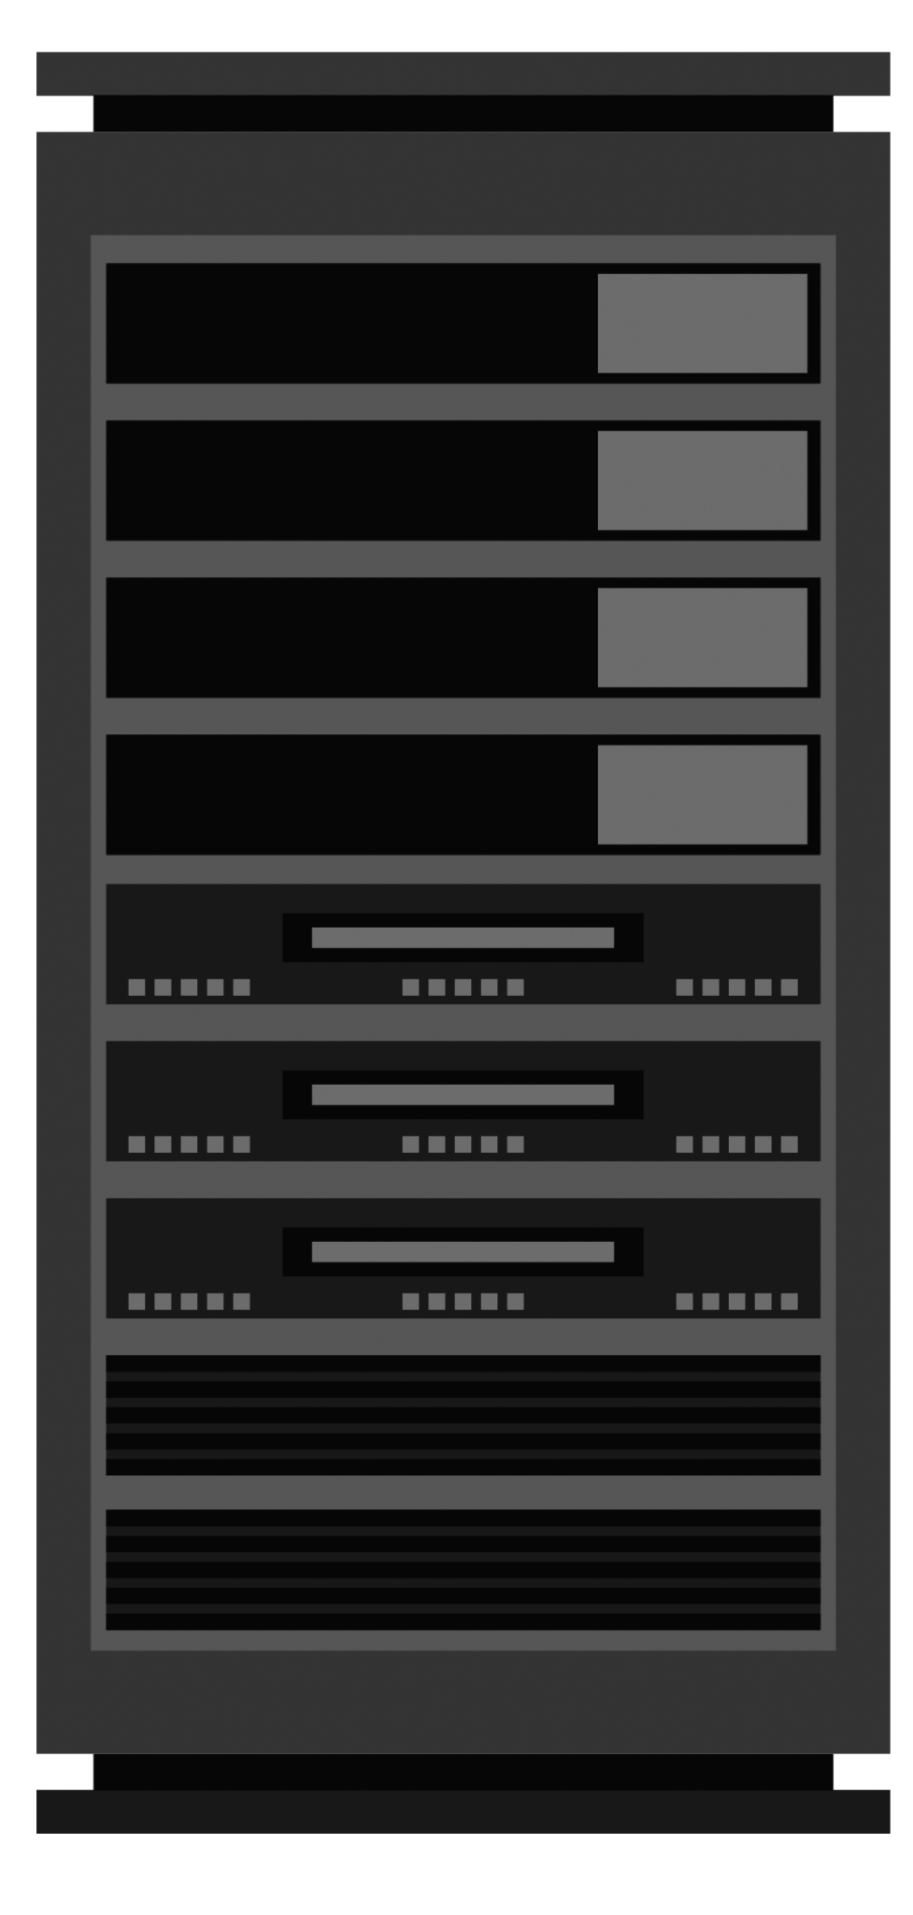
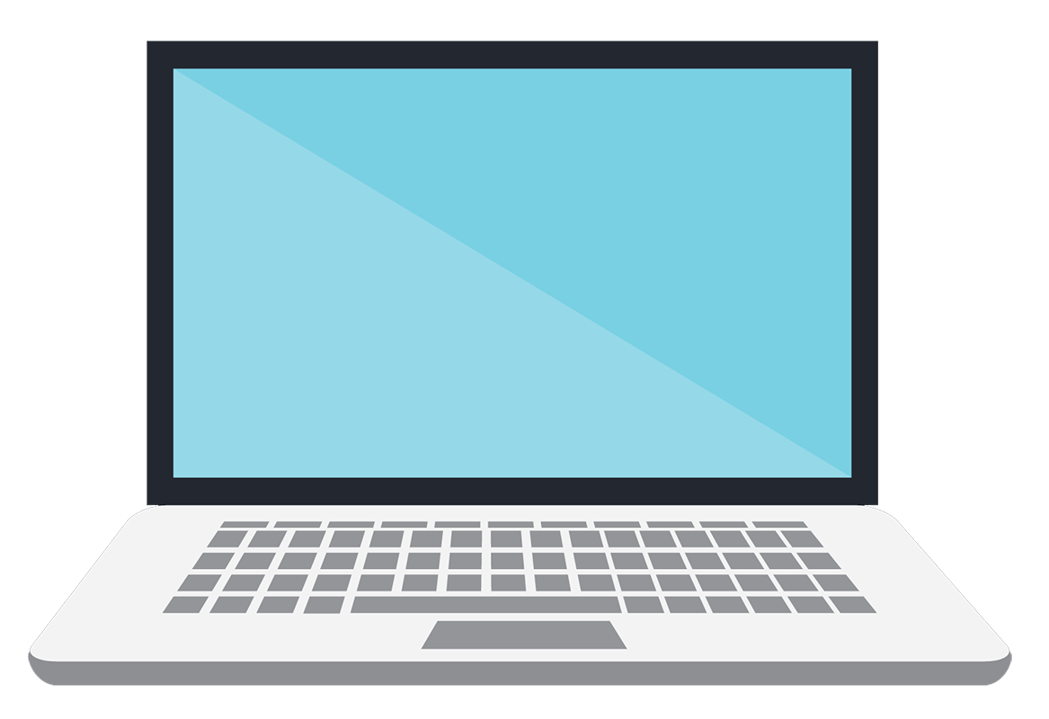
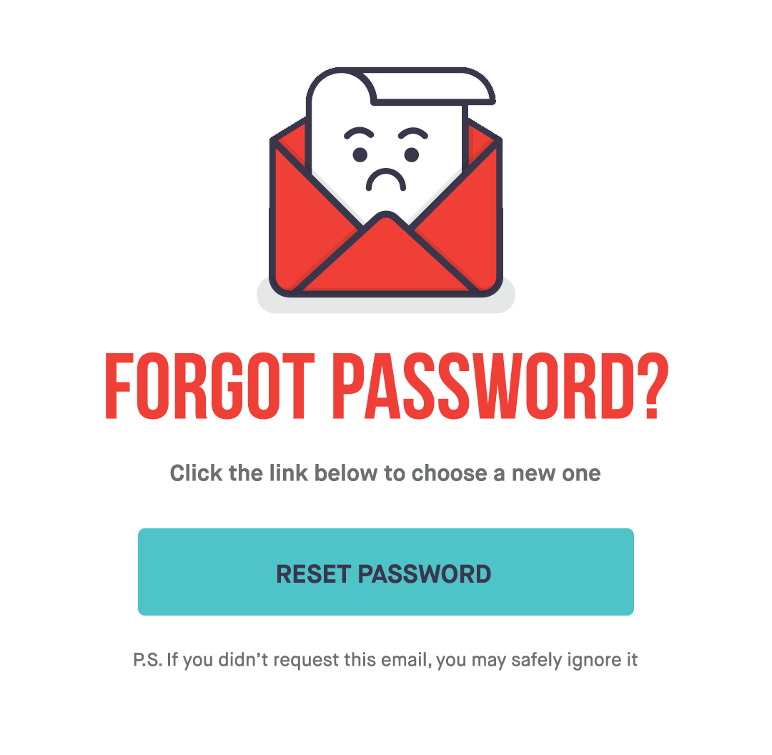
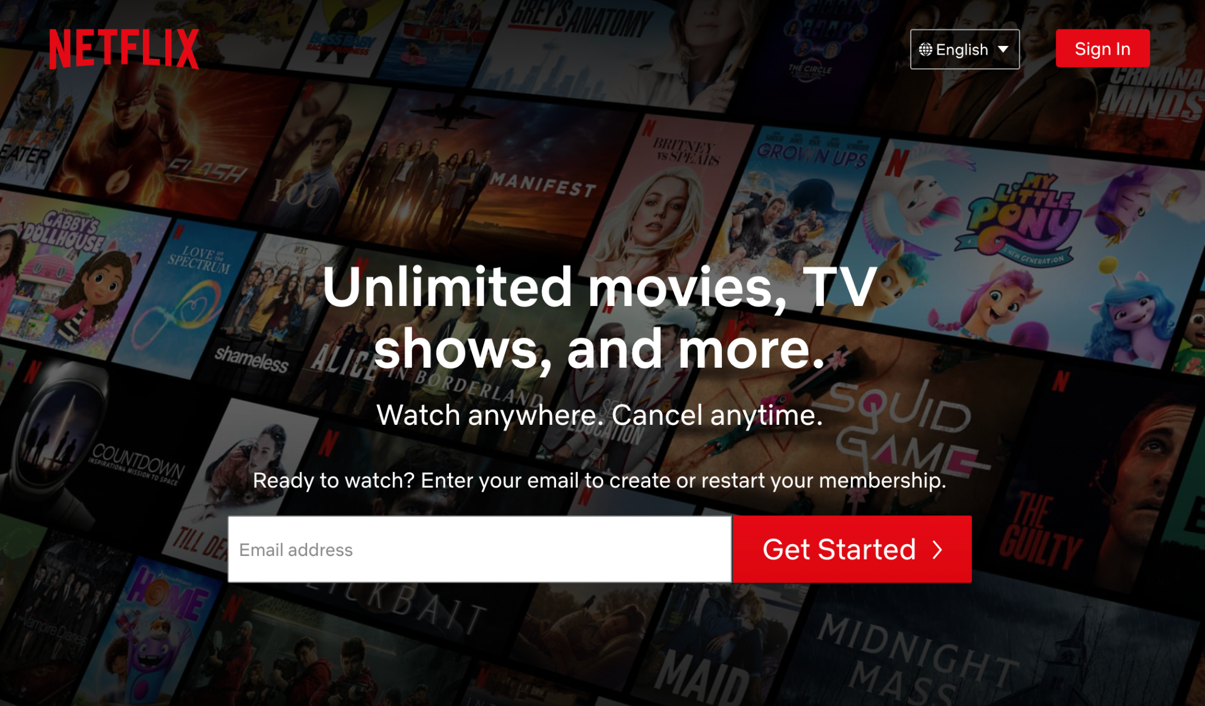

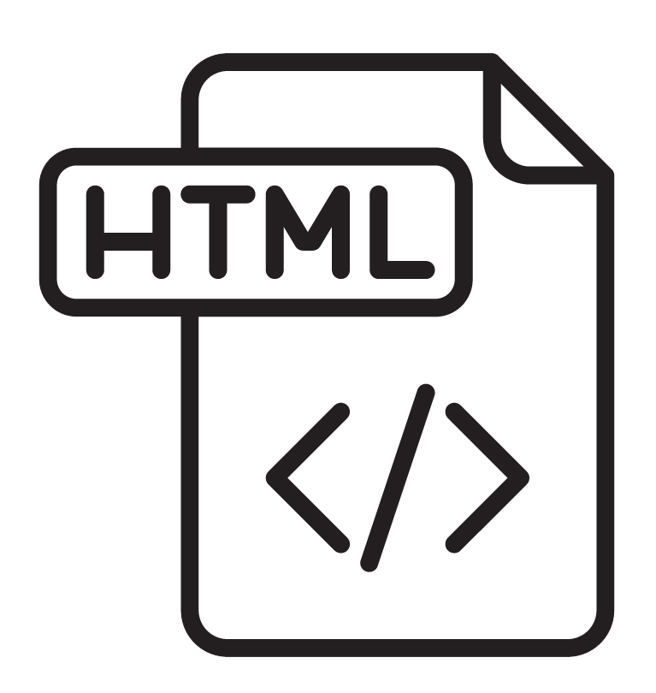
Browsers Access Information on the Web
Every webpage, image, and video on the web can be accessed via a specific Uniform Resource Locator (URL). Browsers use the URL to retrieve resources from a web server and display them on a user's device.
https://www.netflix.com/
Request
Response
Client 12.34.56.78
Netflix Server
41.65.88.90

Slide 5
What is an API?

Slide 6
An API (Application Programming Interface) is a set of methods, properties, events, and URLs that developers use to interact with components of a user’s web browser.

Slide 7

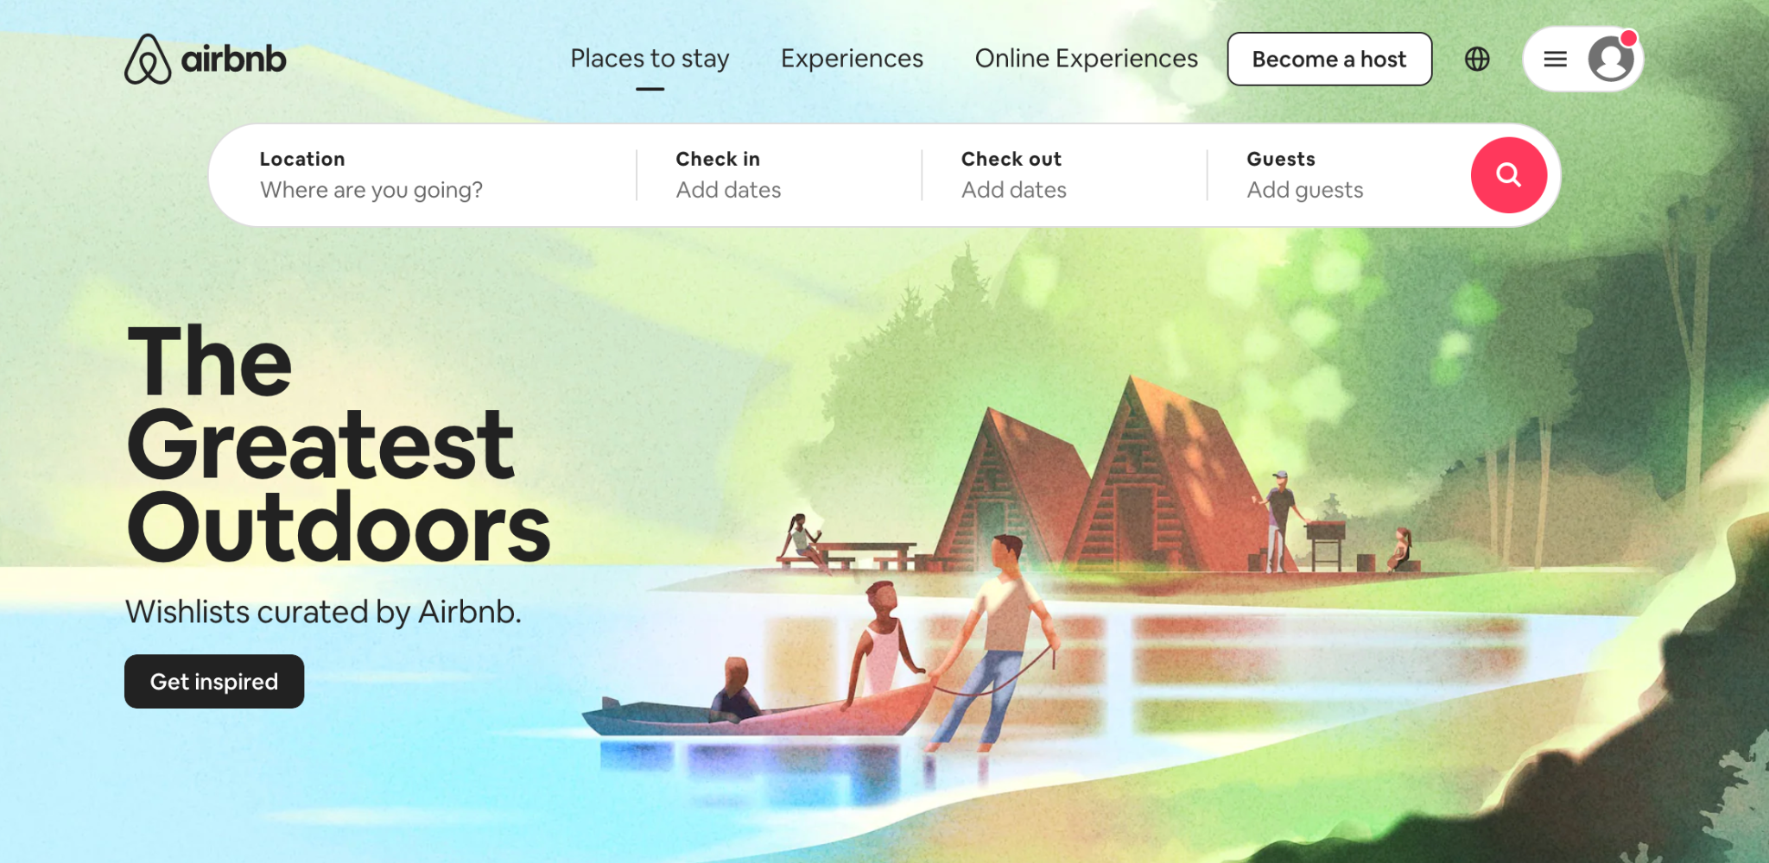
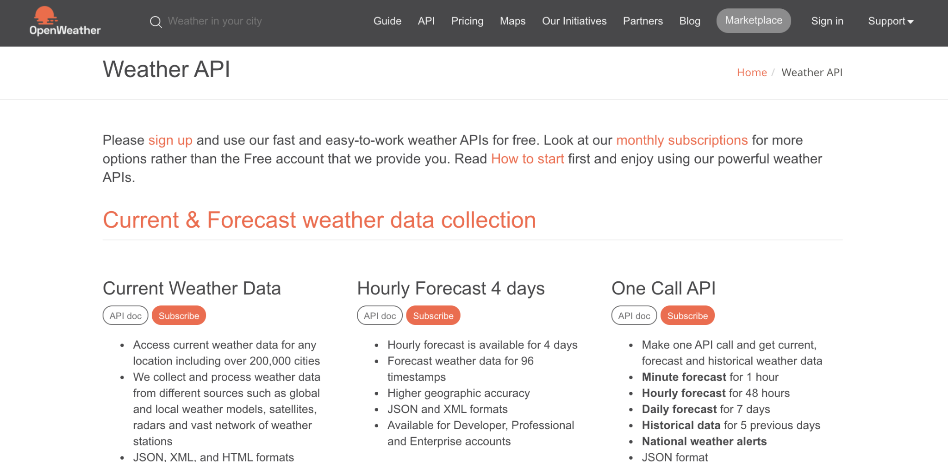
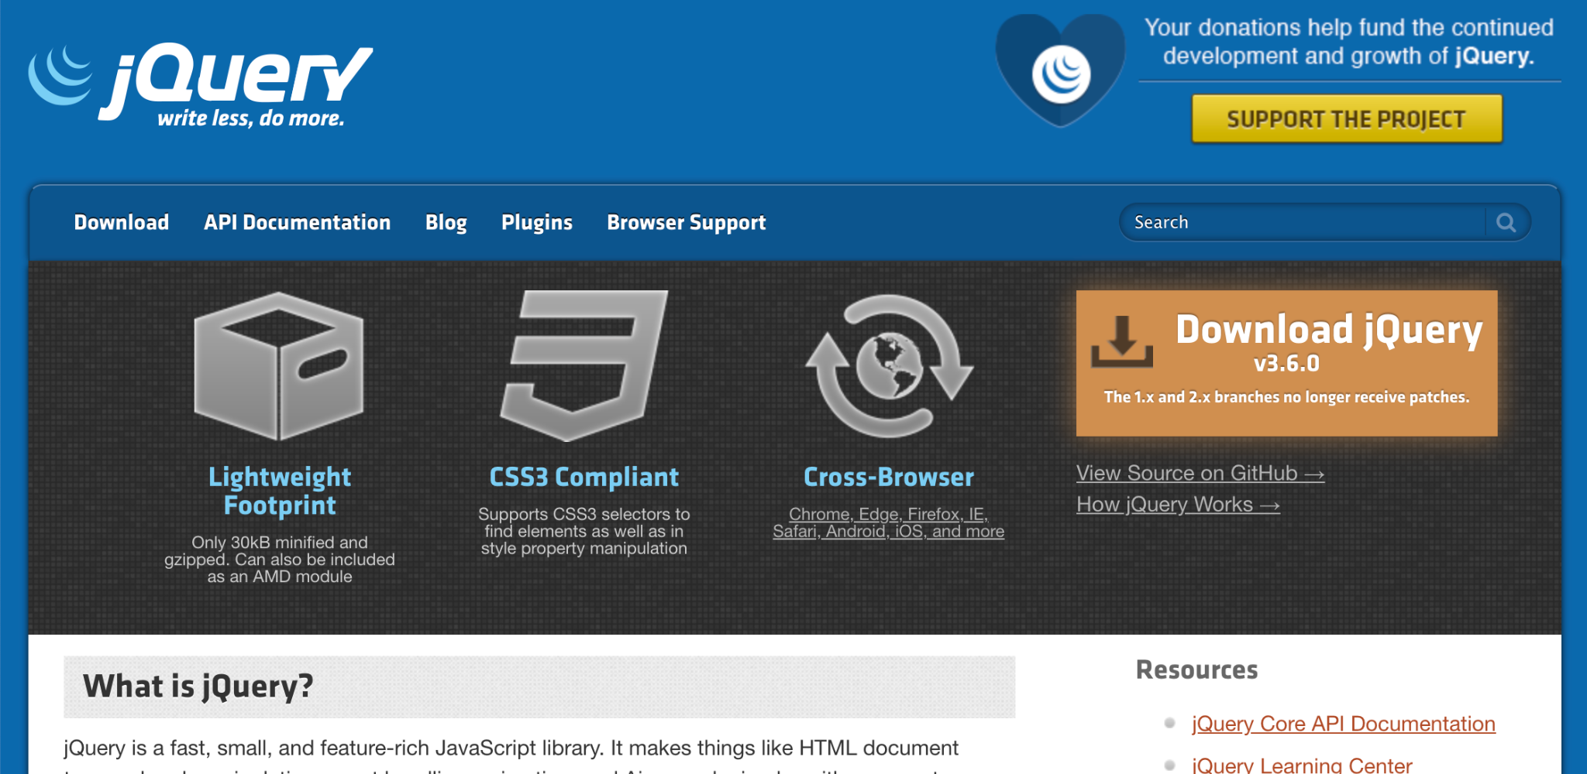
Application Programming Interface
APIs can also interact with data sets, hardware or software on a user’s computer, and third-party software and services.
AirBNB uses Google’s API for maps
Google Searches for weather uses the Weather API
Even jQuery is an API

Slide 8
What is a Web API?

Slide 9
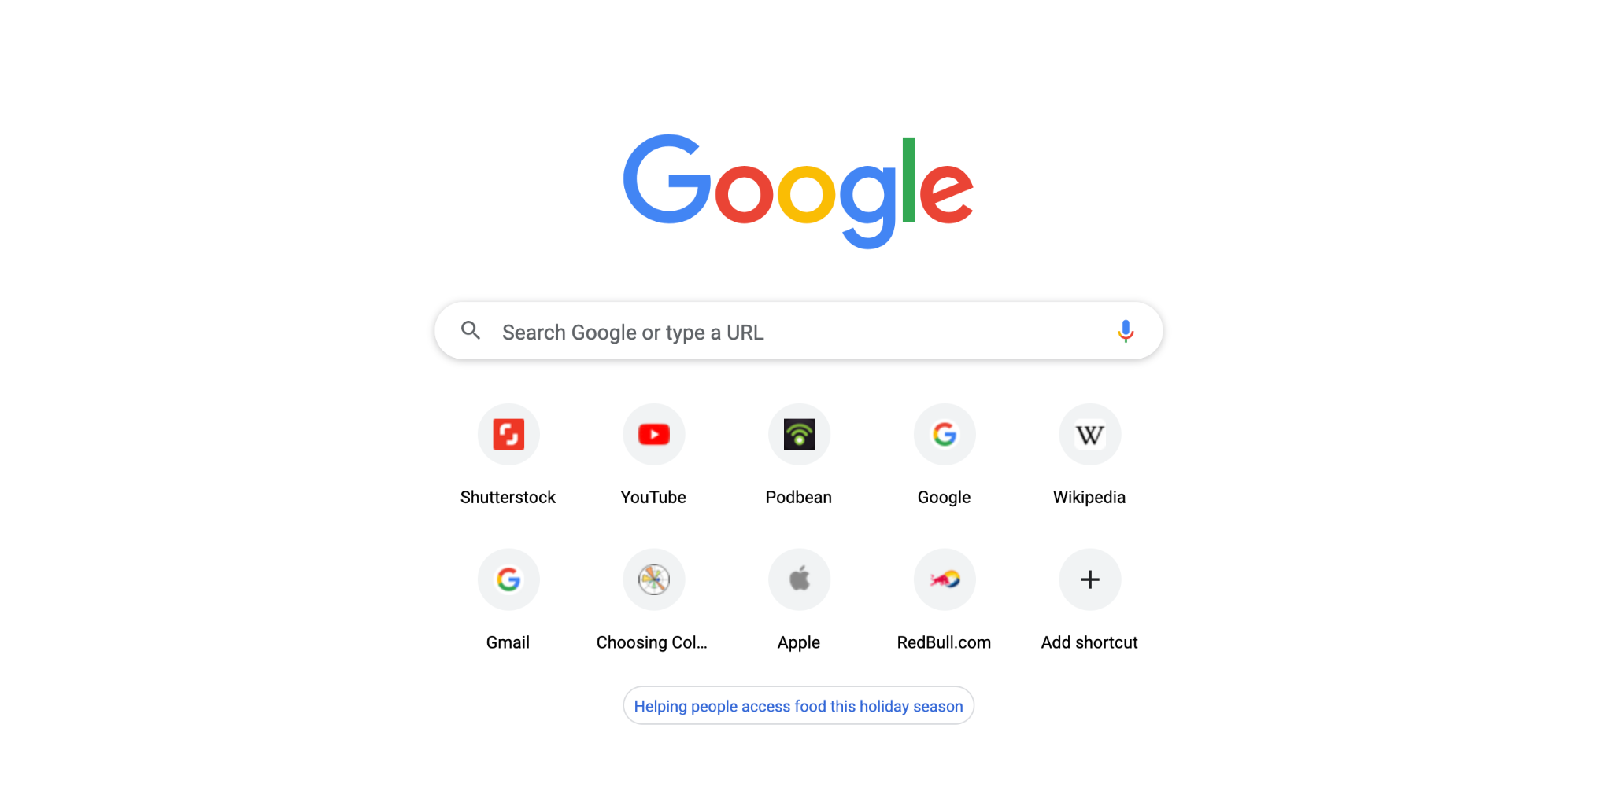

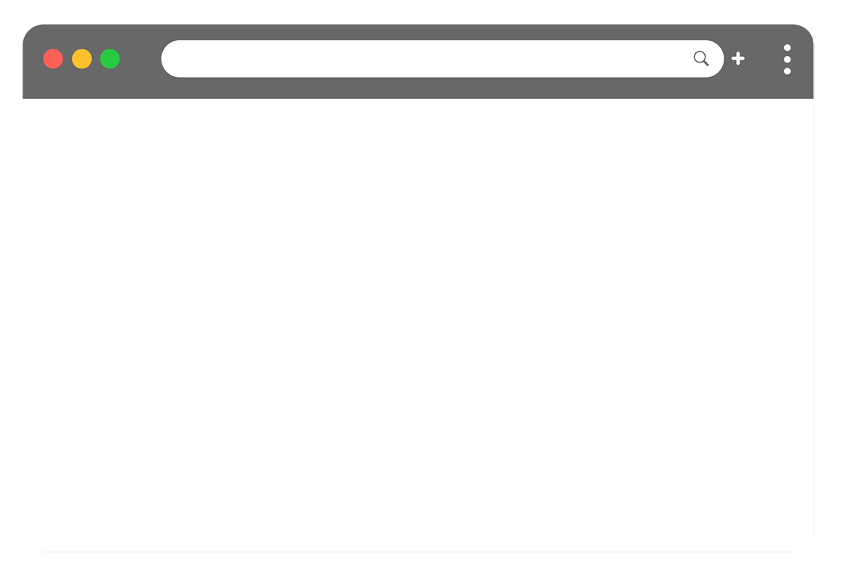
Web APIs Use JavaScript to Manipulate Webpages
Web APIs are built into the web browser and contain methods that allow us to manipulate a webpage using JavaScript.
Browser APIs
Core JavaScript Language

Slide 10
We use Web APIs to create elements and add them to the browser or to add and remove styles and attributes—all via JavaScript.

Slide 11
What is the DOM?

Slide 12
The Document Object Model
When we open a webpage, the browser creates a tree of objects that represent the opened page. That tree of objects is the DOM, or Document Object Model.
Document
Root element <html>
Element <head>
Element <body>
Element <title>
Attribute “href”
Element <a>
Element <h1>
Text “My title”
Text “My link”
Text “My header”

Slide 13
Using the DOM, we can manipulate the HTML elements on the page via JavaScript.

Slide 14
Mini Project

